Slide 1

Dissertation Briefing
Liangxiao LI
6.26

Slide 2
Table of Content
Research Motivation
Research Question
Literature Review
Data Source
My Model Development Idea & Timeline

Slide 3
Research Motivation (Improve Black-Litterman, the portfolio optimizer)
Black-Litterman improves MVO by using posterior E[R’], created from prior and Likelihood
Prior (E[R]): Derived under assumption of ’efficient market’ (CAPM Model)
Likelihood(Investor Views Q): Subjective views manually input by investor, hard to quantify and usually biased
My Goal: Enhance Black-Litterman by integrating data-driven priors and investor views
Prior(E[R]): Macro + Fundamental Data (Company Financials Balance Sheet, Income statement, Cashflow Statement)
Likelihood(Investor Views Q): Apply 13 F Data, offer higher weight on investor view to Hedge Fund with higher portfolio
Return

Slide 4
Research question
Will this hybrid Black-Litterman model improve MVPO than the Original Black-Litterman model?
Return

Slide 5
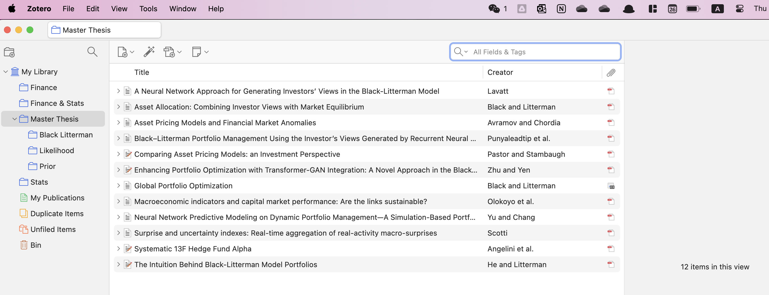
Literature Review
Enhancing Prior (E[R])
Yu & Chang (2020): apply Neural network to link macroeconomic indicators with expected return
Simple MLP
Yahoo Finance daily price S&P 500 components as portfolio
Enhancing Likelihood(Investor’s view Q)
Zhu & Yen (2024): Generate Likelihood using Transformer-GAN from Time Series and sentiment data
Forecast one week ahead and incorporate that as investor’s view
Angelini (2019): Copycat investing – Extract Alpha from 13 F hedge fund filling, lack integration into Bayesian framework
Return

Slide 6
Angelini (2019) - Copycat investing
Key innovation A: 2 interpretable measures
Conviction: Stocks with the highest weight in a manager's portfolio.
Consensus: Stocks held by the largest number of hedge fund managers.
Key innovation B: 1 investor subgroup – Fundamental Equity Hedge Funds (FEHF)
Higher portfolio concentration
Longer Holding periods
More independent conviction
Combined Strategy: Top 50 High-conviction & Consensus Stocks from FEHF

Slide 7
Data Sources
Macro: Bloomberg Terminal
Consumer_Confidence: Gauges household optimism on economy, indicator for spending
CPI: Measures inflation by tracking changes in consumer goods and services prices.
GDP: Captures overall economic growth and national output trends.
PMI: Reflects manufacturing sector health and business activity momentum.
Unemployment: Indicates labor market strength and economic slack.
USYC2Y10: The 2Y–10Y yield spread, a classic signal of recession risk when inverted.
US10YRBond: Benchmark risk-free rate used to infer long-term inflation and growth expectations.
Fundamentals: Discounted Cashflow.com
Income Statement
Balance Sheet
Cashflow Statement
13 F Filings: Institutional Holdings
Asset Historical Return: Bloomberg (Historical market share price) Bloomberg(Not yet obtained, bloomberg data open on July)

Slide 8
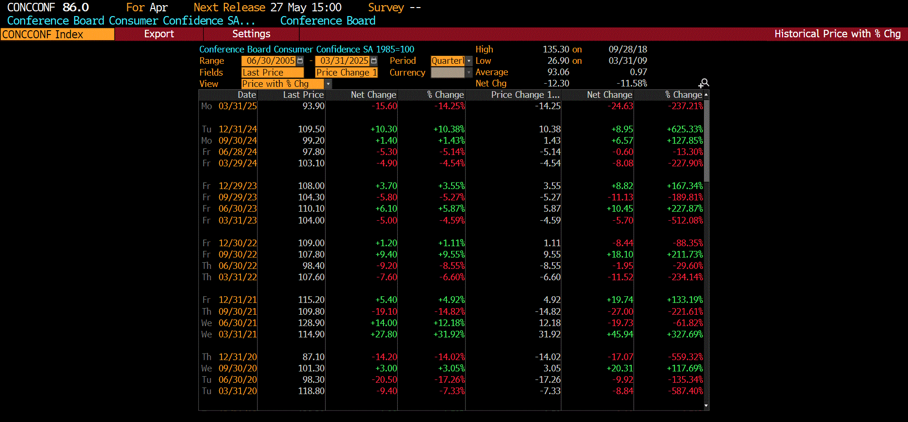
Macro Economic Data: Consumer_Confidence

Slide 9
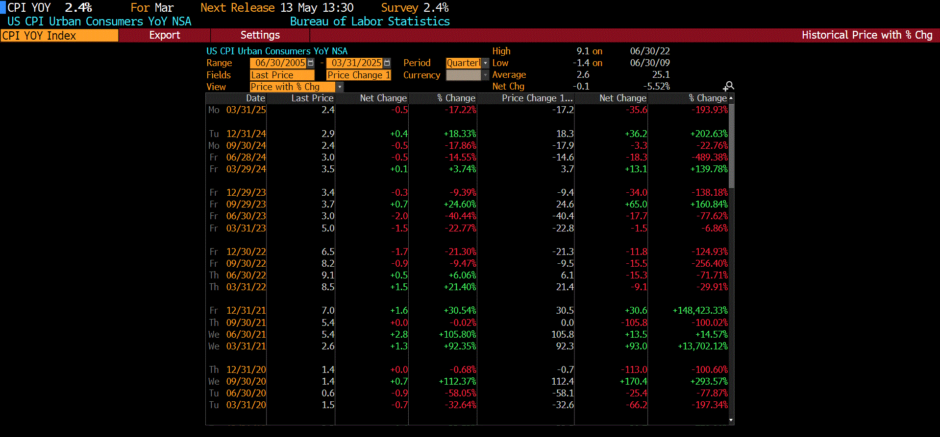
Macro Economic Data - CPI

Slide 10
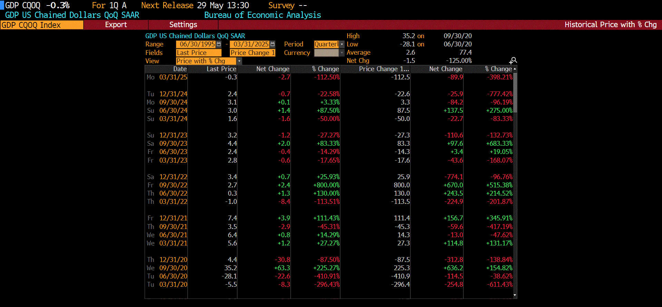
Macro Economic Data - GDP

Slide 11
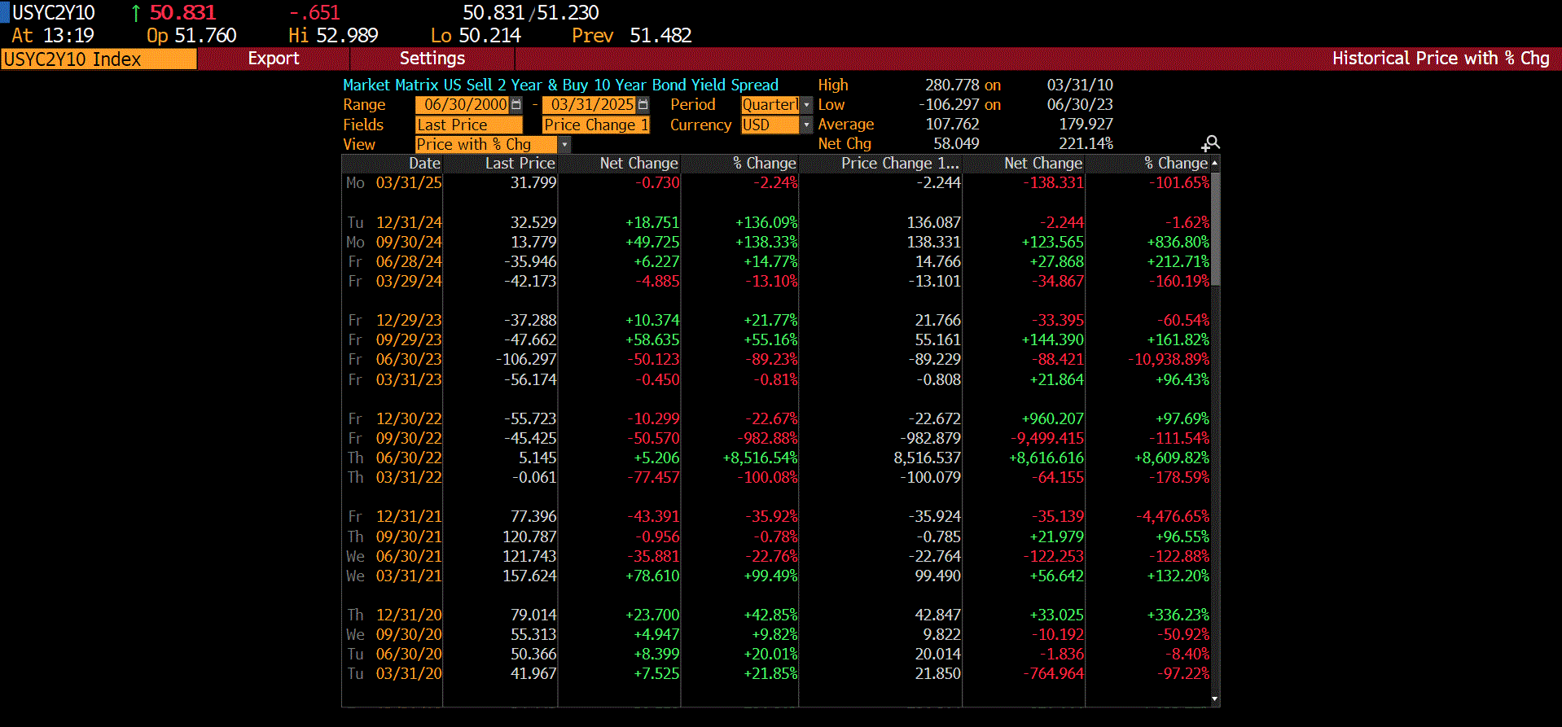
Macro Economic Data – USYC2Y10

Slide 12
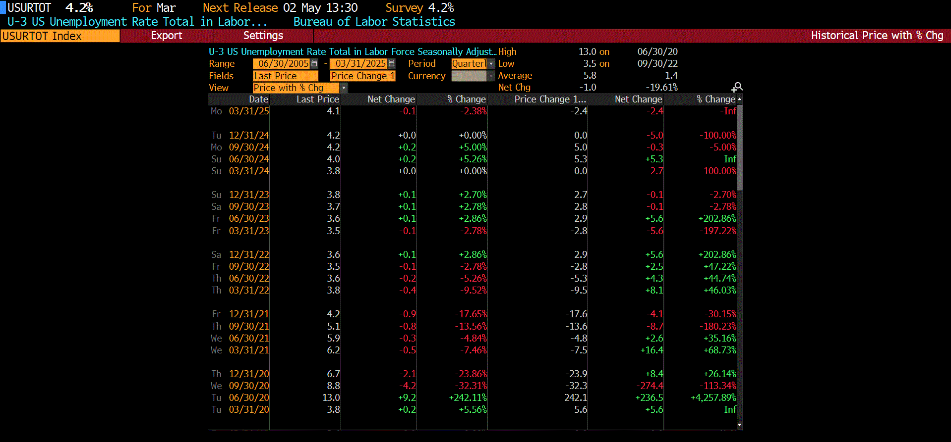
Macro Economic Data - PMI

Slide 13
Macro Economic Data - Unemployment

Slide 14
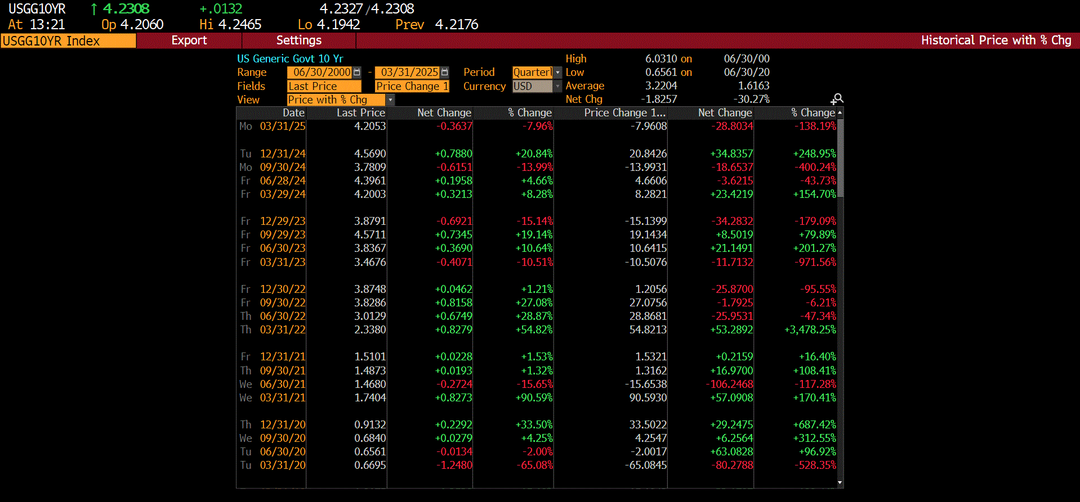
Macro Economic Data – US10YRBond

Slide 15
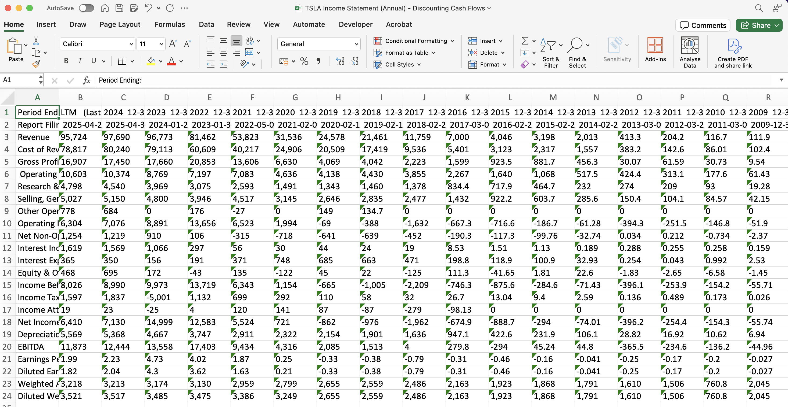
Company Fundamental – Discounted Cashflow.com (Income Statement)

Slide 16
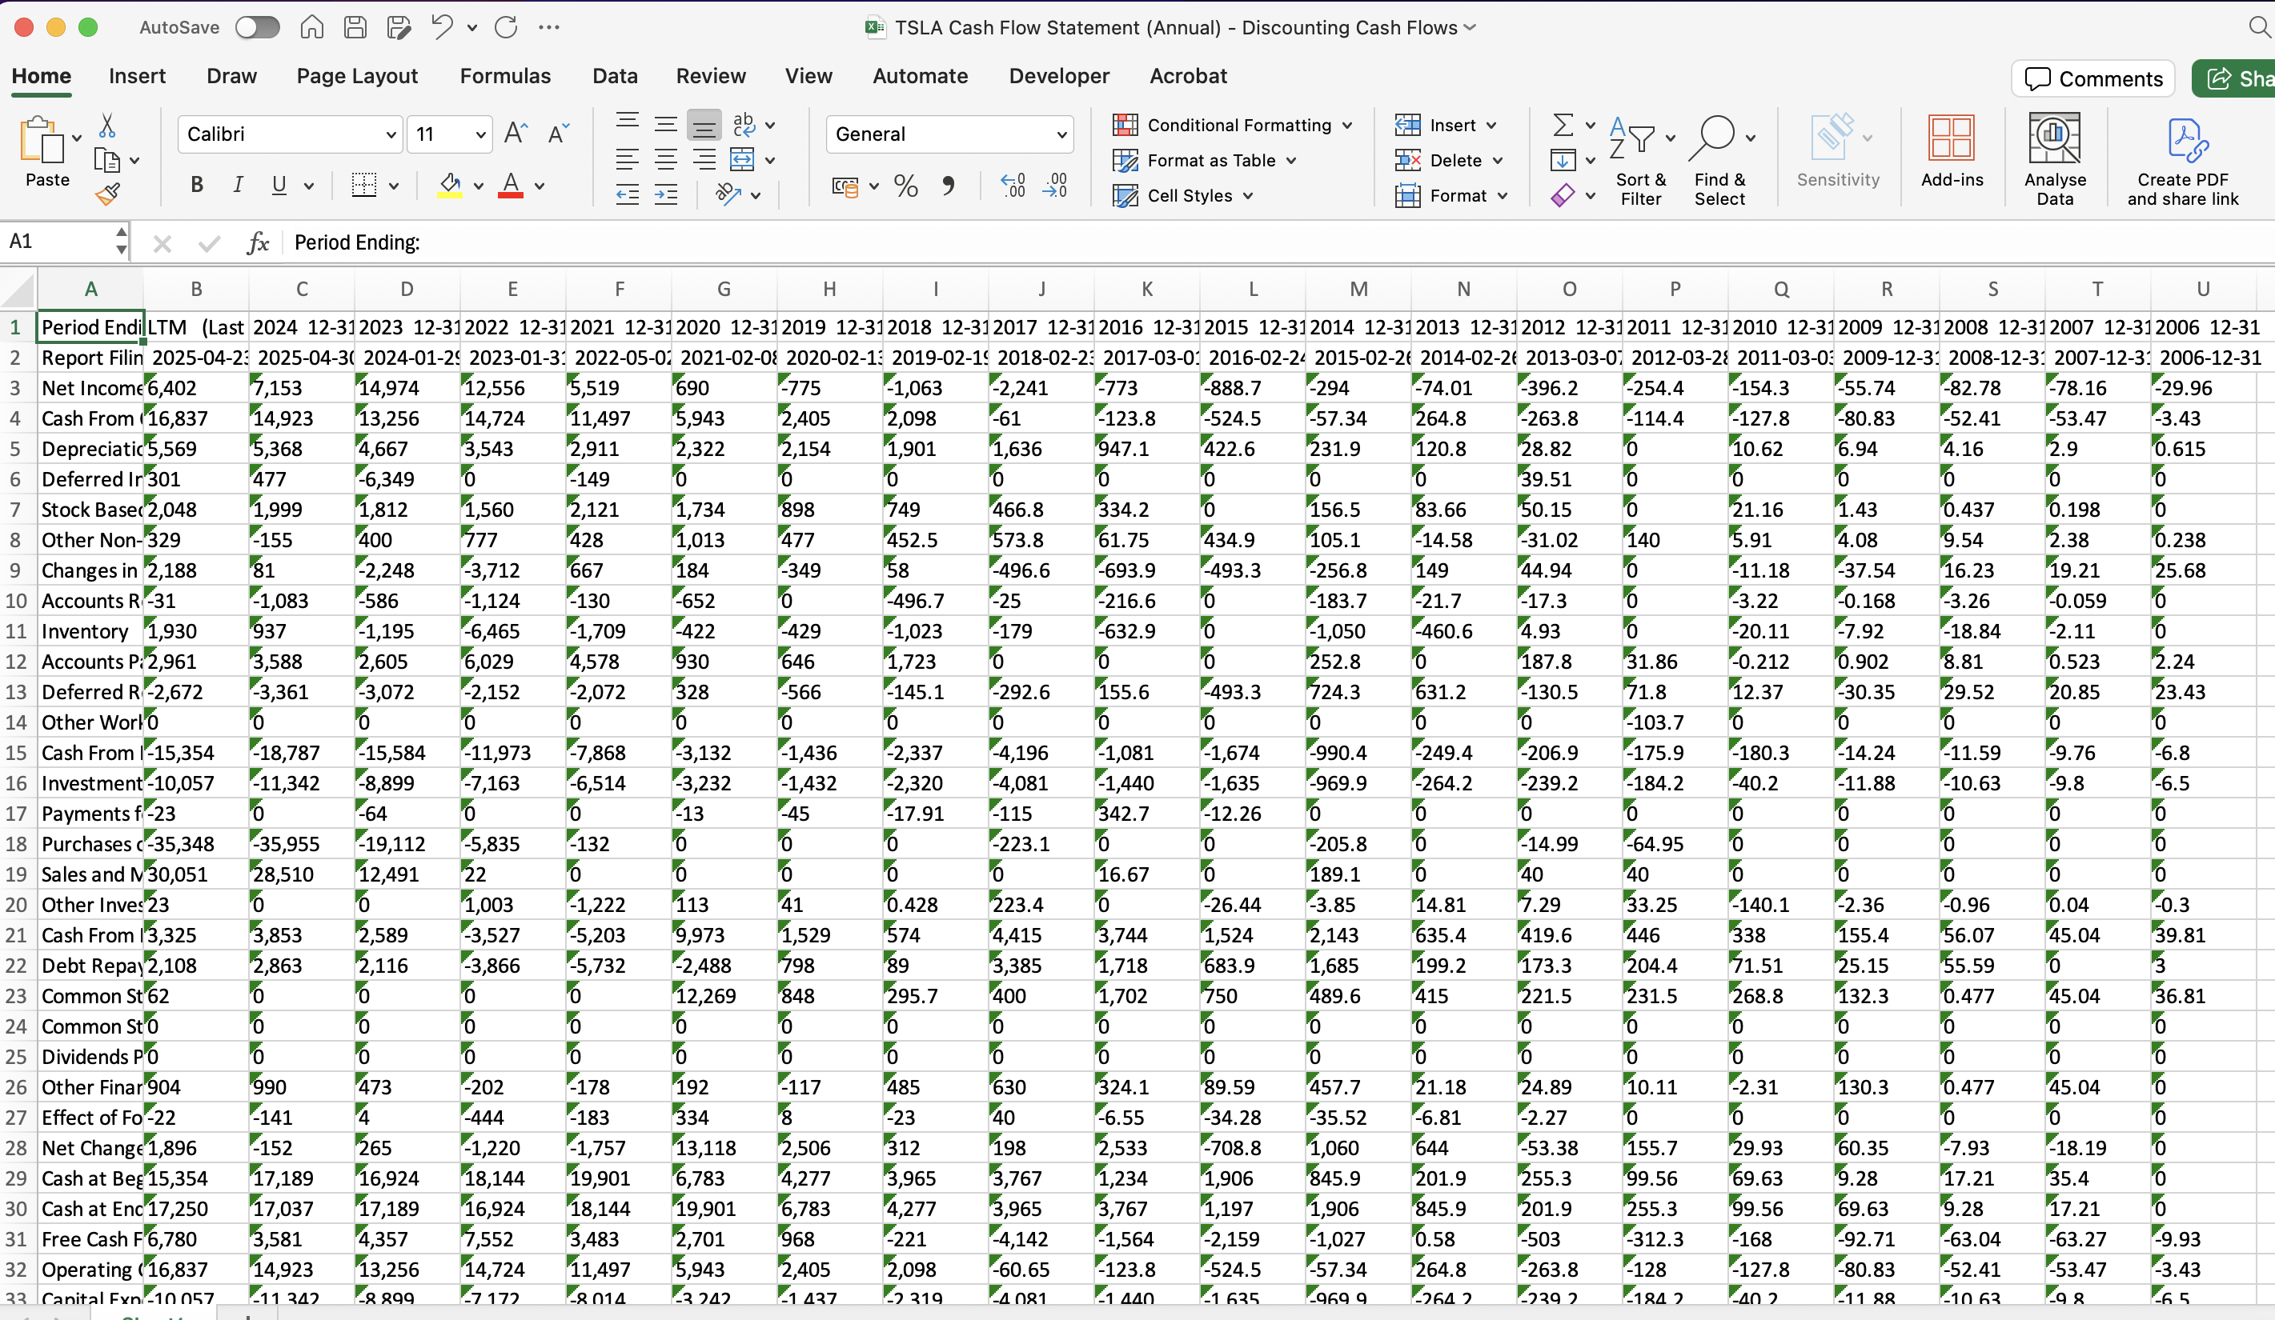
Company Fundamental – Discounted Cashflow.com (Cashflow Statement)

Slide 17
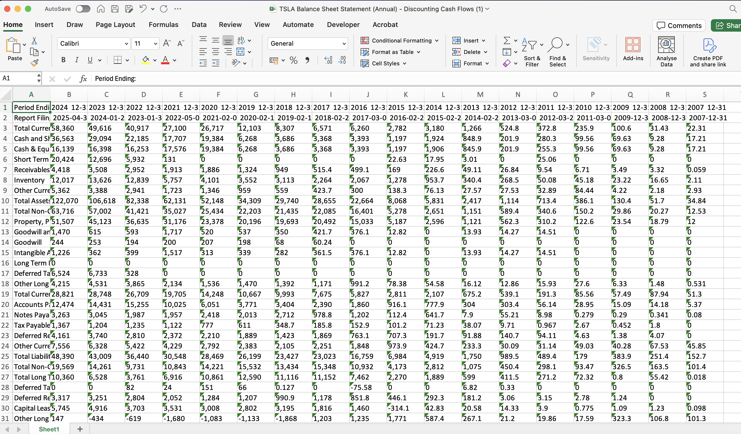
Company Fundamental – Discounted Cashflow.com (Balance Sheet Statement)

Slide 18
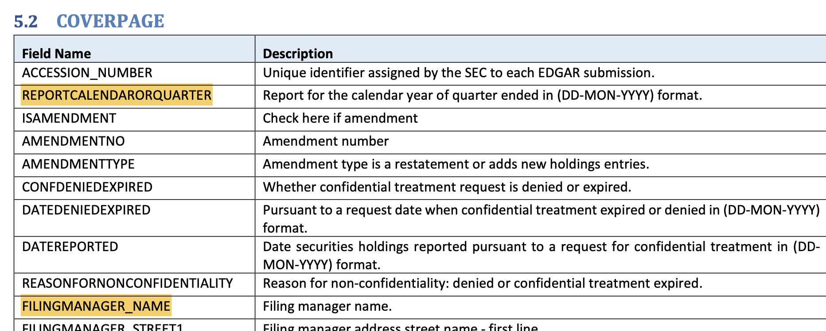
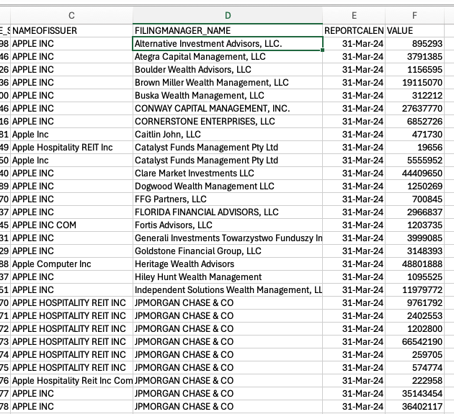
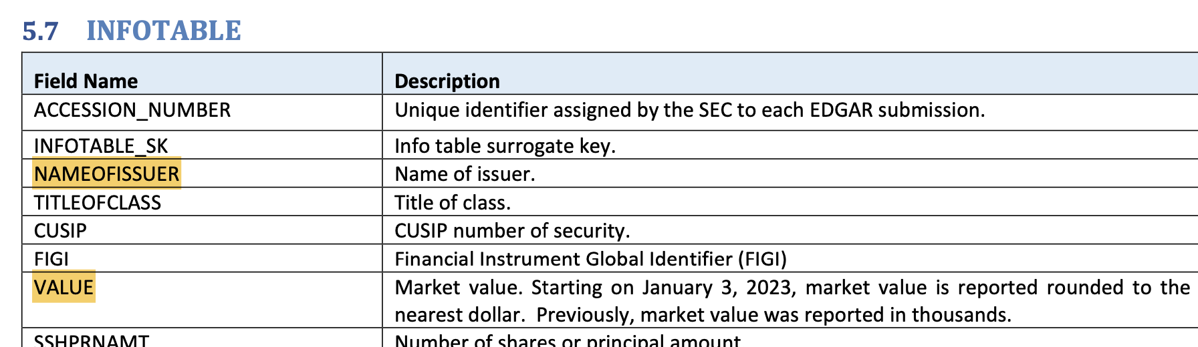
Institution Holdings – 13 F
Return

Slide 19
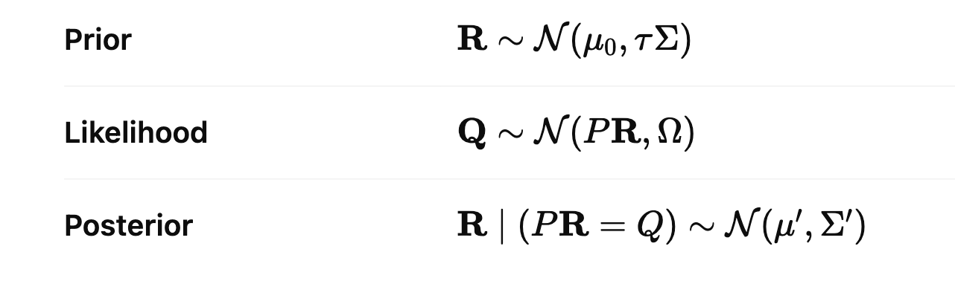
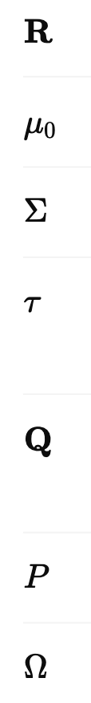
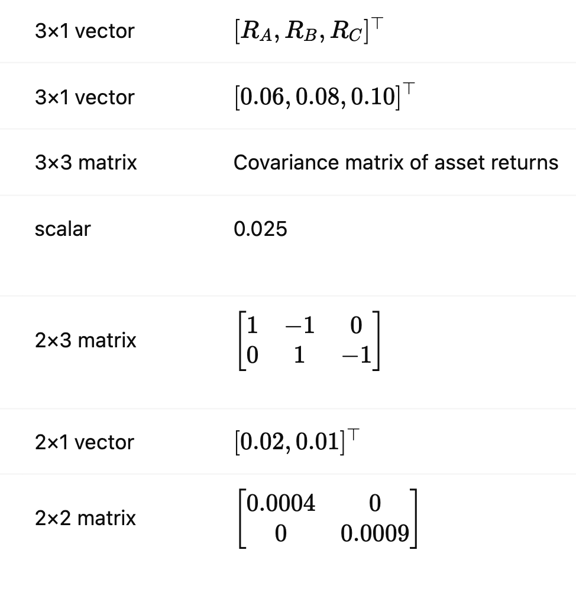
My Model Development Idea
Enhance Prior(E[R]): Macro + Fundamental Data + Historical asset return (Company Financials Balance Sheet, Income statement, Cashflow Statement)
Step1: construct compressed data Z(PCA, Sparse PCA etc.) to link Macro and Fundamental data
Step2: Fit a Farma French/ Barra prediction model, predict R based on Z, where R is the Observed historical return of certain asset
The predicted result of R will be the mean in our new model
Enhance Likelihood(Investor Views Q): 13 F Data
Offer higher weight on investor view to Hedge Fund with higher AUM
Model Evaluation: Compare ROE with other strategies

Slide 20
Timeline
Return
June 26 | Supervisor meeting
June 27-July 3 | Data Cleaning
July 4 – July 22 | Model Development | Contact
July 23 – August 4 | Model Development Writing main Chapters | Contact
August 5 – August 15 | Writing main chapters | Contact
August 16-August 22 | Submit draft
August 23- August 29 | Submit to Supervisor for final review
September 1 – September 8 | Final Polish & Submit

Slide 21
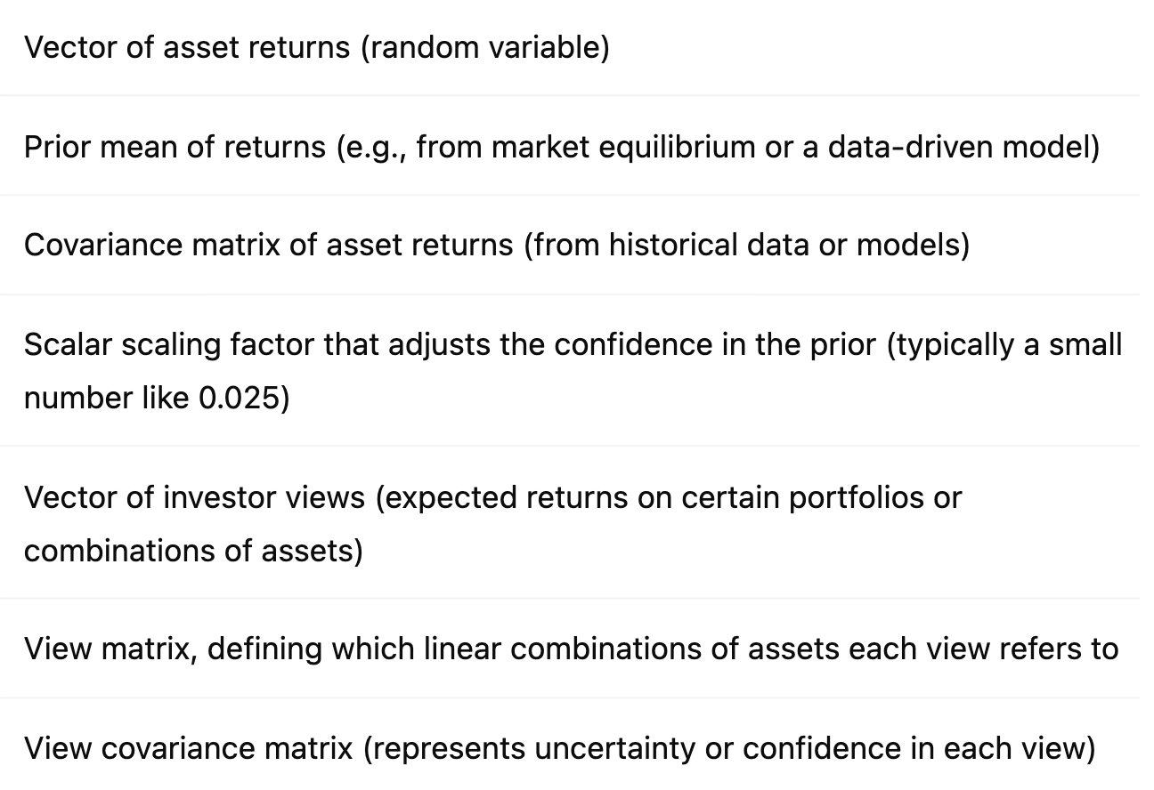
Model breakdown

Slide 22
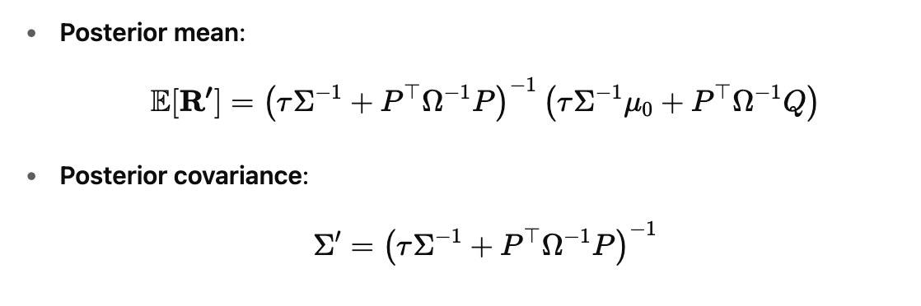
Tutorial Website Model breakdown

Slide 23
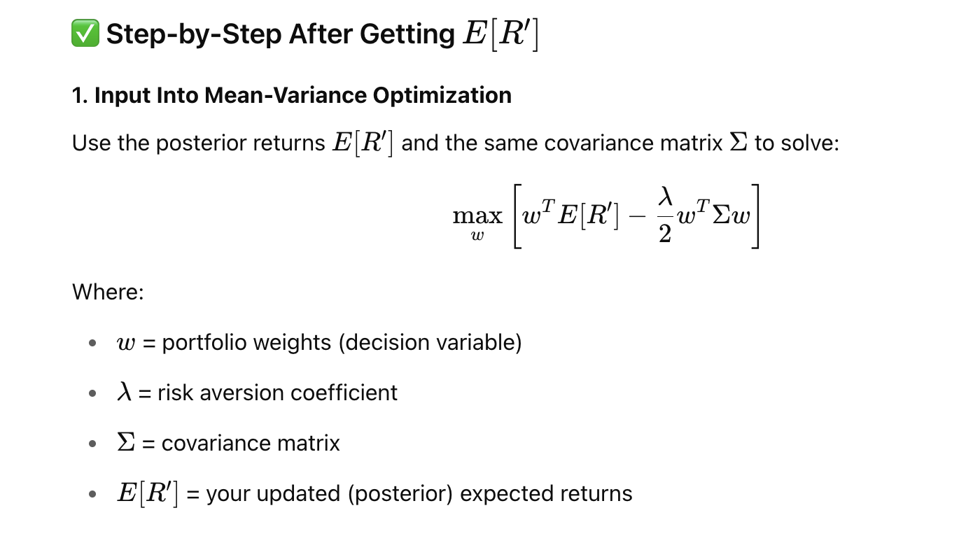
Return

Slide 24
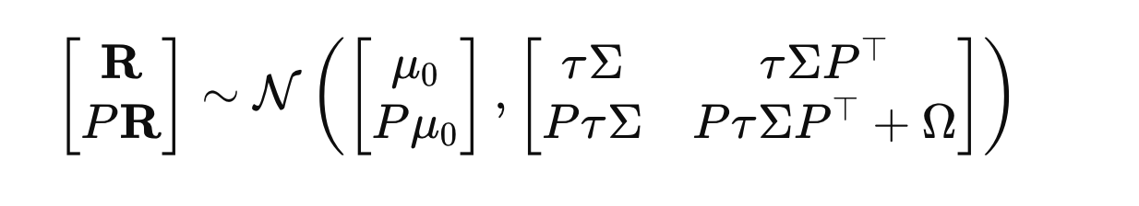
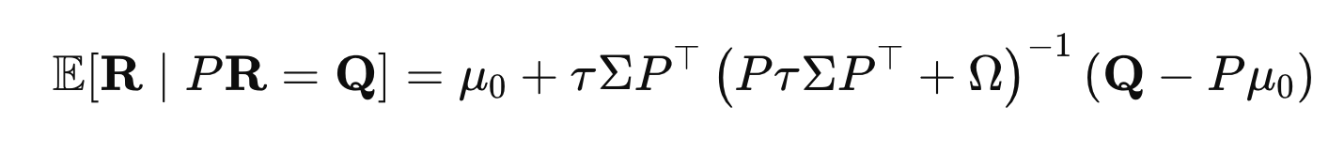
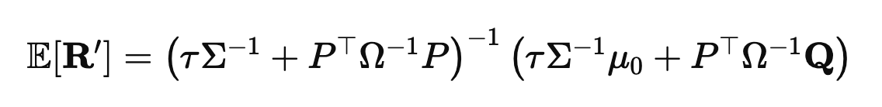
Conditional Normal distribution
Transformation

Slide 25
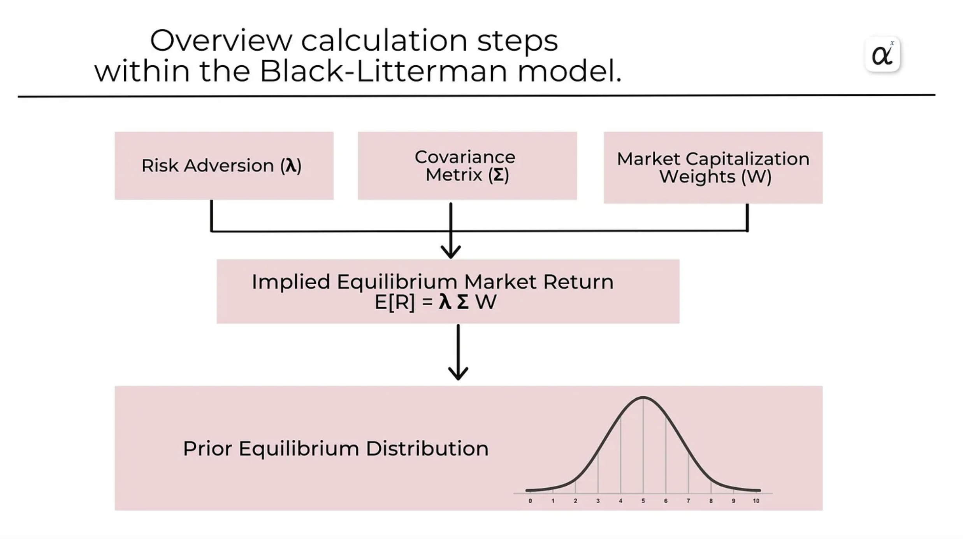
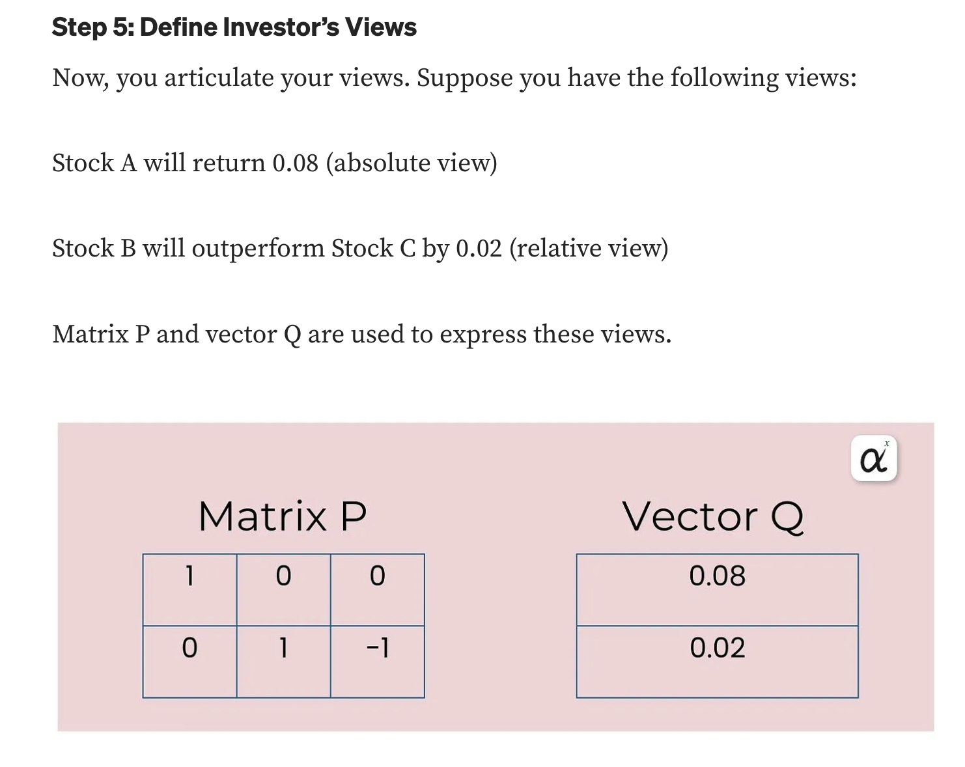
R = (R1,R2,…,Rn)^T, vector of random variables Ri : (random) return of asset i

Slide 26
